Slide 1
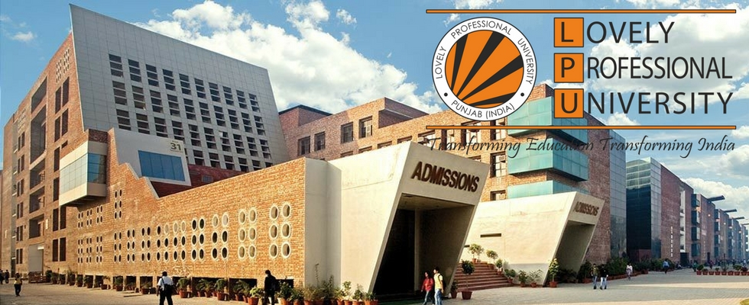
Six Week Summer Training Report
Data Science
Submitted by:- Anubhav Singh Reg. no.: 12208856
Program Name: Bachelors in Computer Applications (BCA)
School of Computer Application Lovely Professional University Phagwara, Punjab (June – July 2024)

Slide 2
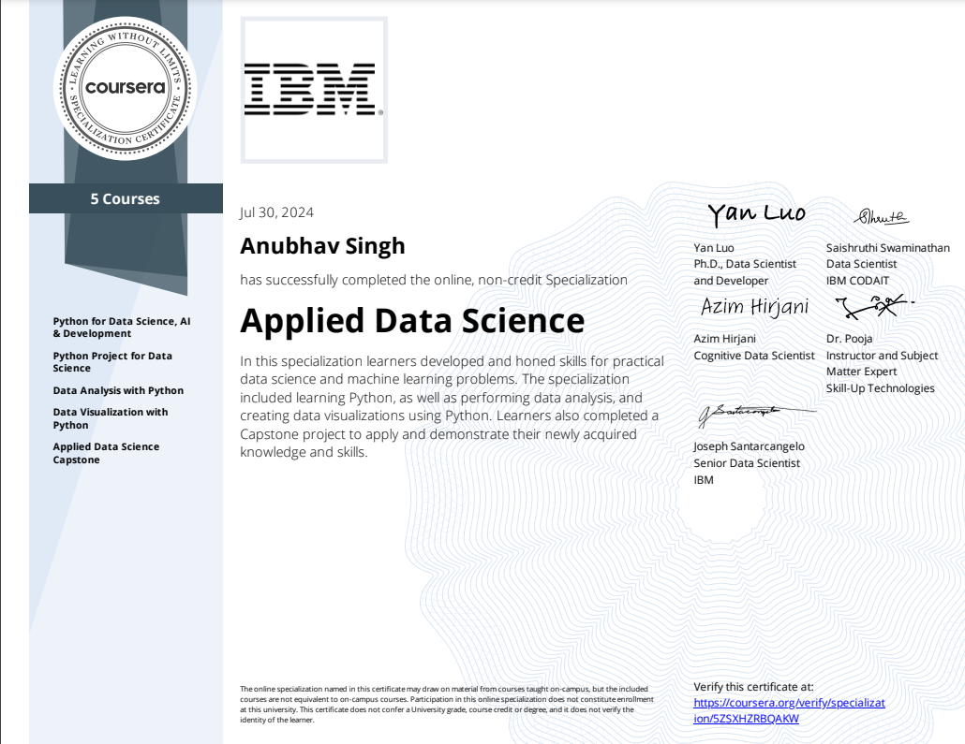

Original Certificate

Slide 3

About the Platform (Coursera)
Introduction to Coursera:
Founded in 2012 by Stanford professors Andrew Ng and Daphne Koller.
Coursera is a global online learning platform that offers a wide range of courses, specializations, professional certificates, and degrees from leading universities and companies.

Slide 4

Mission:
To provide flexible, affordable, and job-relevant online learning to individuals and organizations worldwide.
Vision:
To enable anyone, anywhere, to transform their life through access to the world’s best learning experience.

Slide 5
About the course
Course Title:
Applied Data Science(IBM) – Coursera
Key Focus Areas:
Python for Data Science, AI & Development
Python Project for Data Science
Data Analysis with Python
Data Visualization with Python
Applied Data Science Capstone

Slide 6
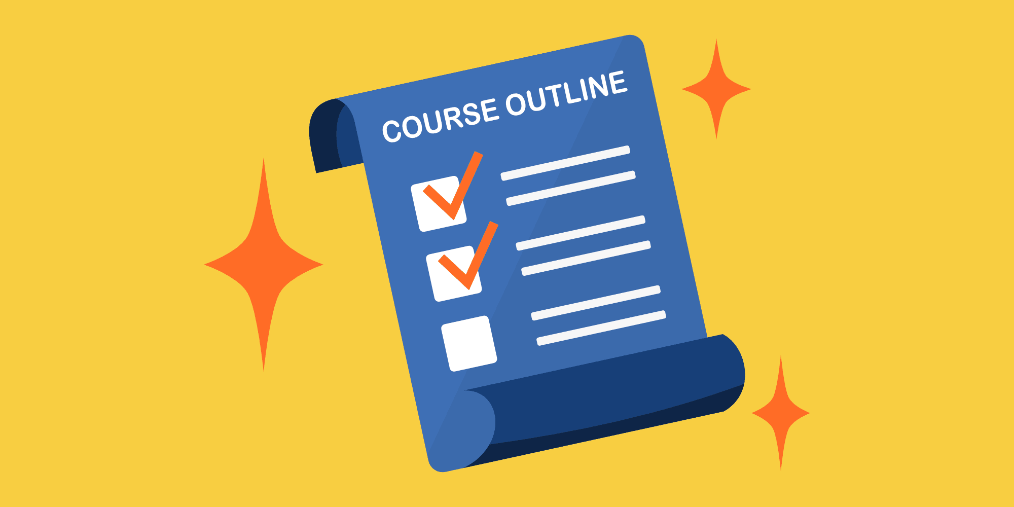
Course Outline
Python for Data Science, AI & Development:
Programming fundamentals
Data structures
Python Project for Data Science:
Practical application
Problem-solving
Project management
Data Analysis with Python:
Data cleaning and preparation
Exploratory data analysis
Statistical analysis
Data Visualization with Python:
Visual storytelling
Chart types
Customization
Applied Data Science Capstone:
End-to-end project
Problem definition
Data collection and cleaning
Model building and evaluation
Project delivery
.

Slide 7
Course Outcome
Skills Required
Basic Programming: Familiar with coding and syntax error correction.
Mathematical Knowledge: Understanding of basic mathematical concepts
Problem-Solving: Strong problem-solving and analytical skills .
Curiosity and Learning Mindset: A willingness to learn new concepts and technologies.
Attention to Detail: Meticulous attention to detail for data cleaning and analysis.
Strong Foundation in Data Science: Develop a solid understanding of data science concepts, tools.
Data Manipulation and Analysis: Master techniques for cleaning, analyzing data using libraries like Pandas and NumPy.
Data Visualization: Effectively communicate data insights through visualizations using Matplotlib, and other tools.
Machine Learning: Build and train models for prediction, classification, and other tasks.
Project Management: Develop project management skills to execute data science project.

Slide 8

Self Made Project Description:-
Project Title: Applied Data Science with R based on previous year Dataset and we have made google form to collect data and perform data analysis on it .
Objective: To learn and apply advanced data science techniques using Python .
Key Tasks:
Data wrangling and visualization with Python libraries.
Building predictive models using machine learning algorithms.

Slide 9
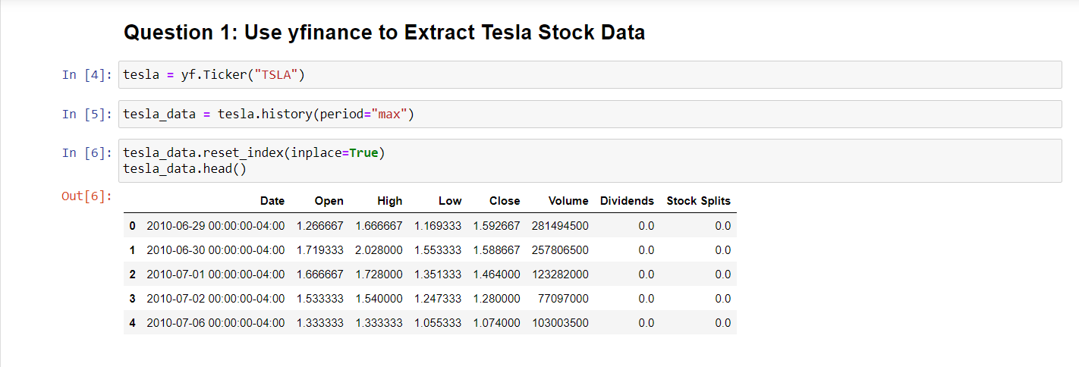

Slide 10
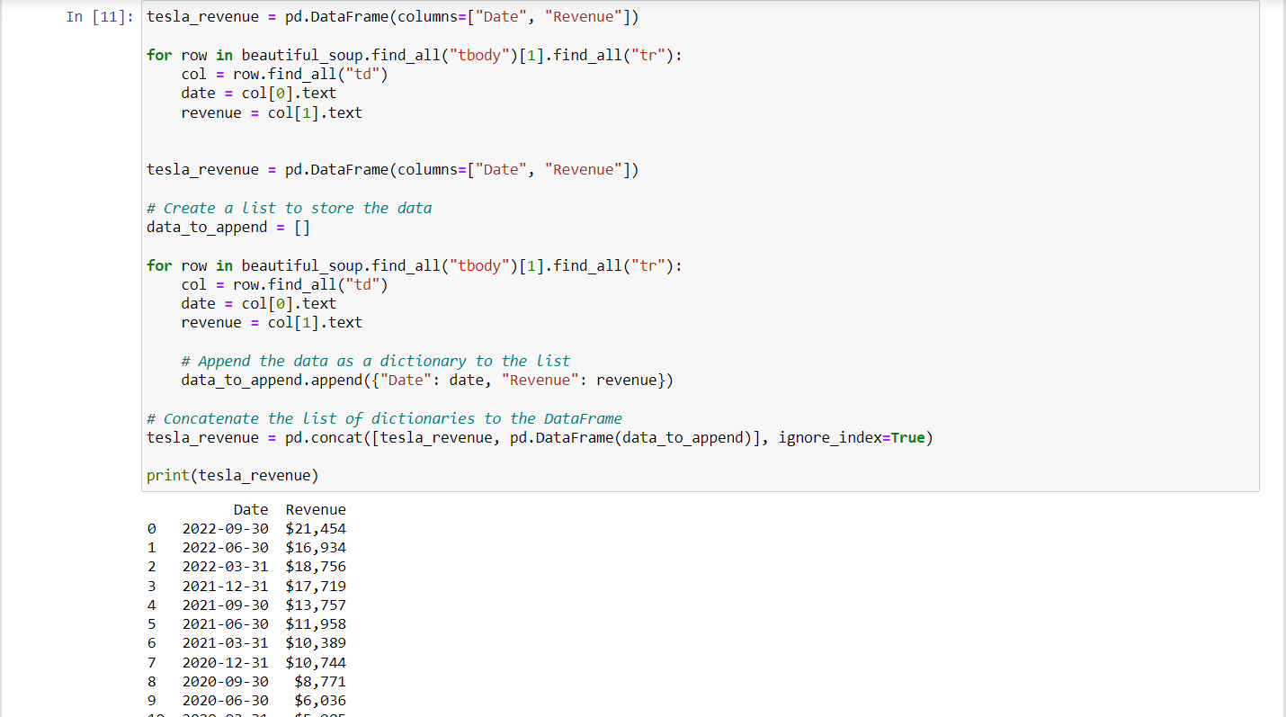

Slide 11
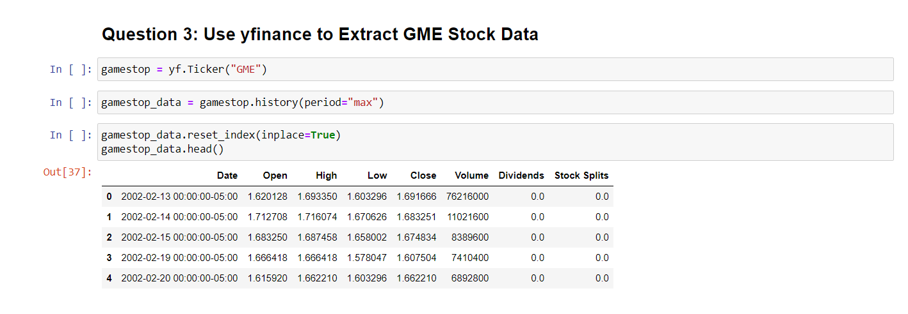
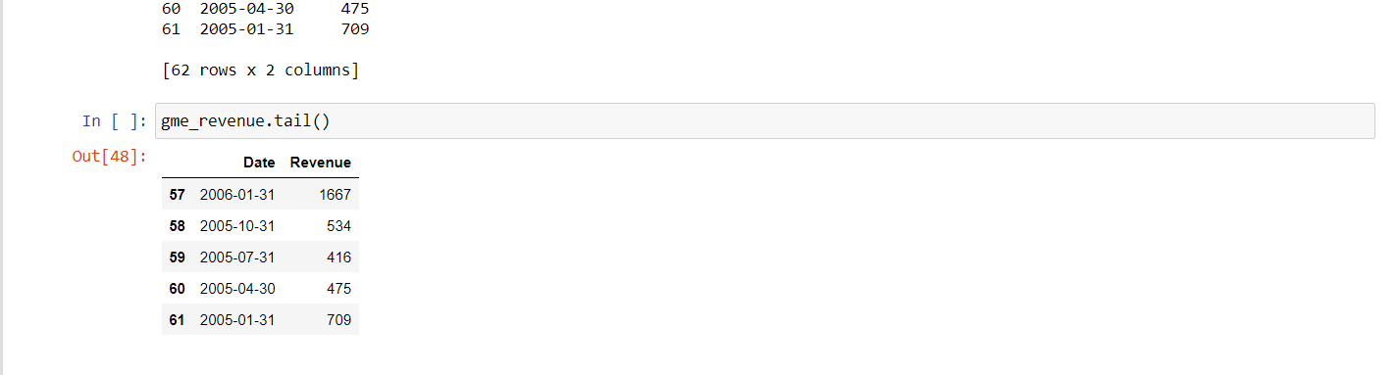

Slide 12

Project Scope and Importance
Scope:
Designed real-time dashboards using Python .
Python for big data analytics.
Data analysis is done on data set which we collected from google form .
Importance:
Gained hands-on experience in solving complex data problems.
Developed skills in high-demand areas of data science.
Useful in industries like business analytics, project development, and research.

Slide 13
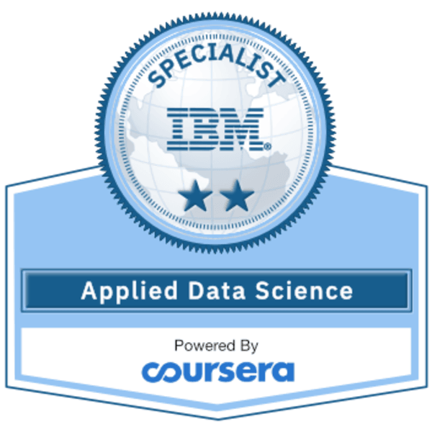
Course Applicability
Key Areas:
Data Scientists
Data Analysts
Data Engineers
Software Developers
Business Analysts

Slide 14
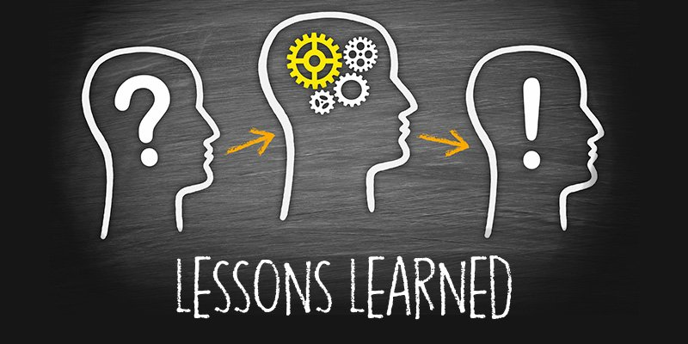
Lessons Learned
Python for Data Science, AI & Development:
Master the fundamentals of Python programming and its applications in data science.
Python Project for Data Science:
Gain practical experience in applying data science techniques to real-world problems.
Data Analysis with Python:
Learn to clean, explore, and analyze data using Python libraries.
Data Visualization with Python:
Develop skills in creating effective data visualizations to communicate insights.
Applied Data Science Capstone:
Apply your knowledge to a comprehensive data science project, demonstrating your ability to solve real-world problems

Slide 15

Conclusion and Future Steps
In conclusion, my learning journey has been a transformative experience ﬁlled with growth and discovery. I am excited to apply the knowledge and skills gained in my future pursuits. I look forward to continuing my and embracing new challenges.

Slide 16
Thankyou
Submitted by-
Name-Anubhav Singh
Reg no.-12208856

